Slide 1
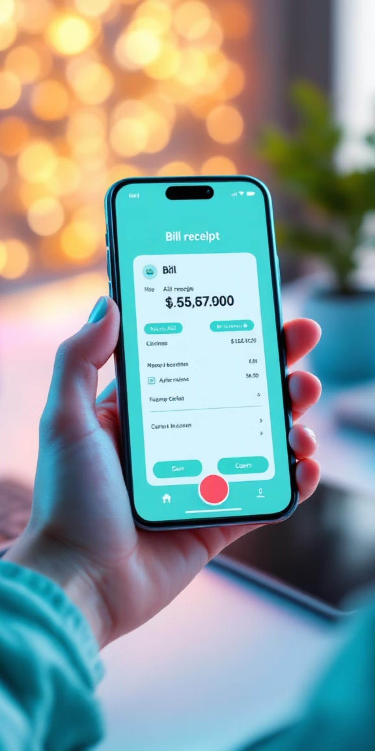
Receipt & Invoice Digitizer (MydigiBill)
Smart Receipt & Expense Tracker

Slide 2

Problem Statement
Manual handling of receipts and invoices is:
Time-consuming
Error-prone
Difficult to organize
Businesses generate receipts in:
Images
PDFs
Scanned formats
Need an automated system to:
Digitize documents
Extract readable text
Prepare data for intelligent processing

Slide 3
Project Overview
MydigiBill is a smart system that:
Accepts receipt/invoice files
Extracts text using OCR
Uses AI to understand and structure data
Stores and analyzes expenses

Slide 4
Objective
Milestone-1 Goals:
Implement file upload functionality
Preprocess documents for OCR
Extract raw text accurately
Support multiple receipt formats
Prepare OCR output for AI mapping

Slide 5
Milestone-1 Scope
File upload (Image & PDF)
Image preprocessing
OCR text extraction
Raw text validation

Slide 6
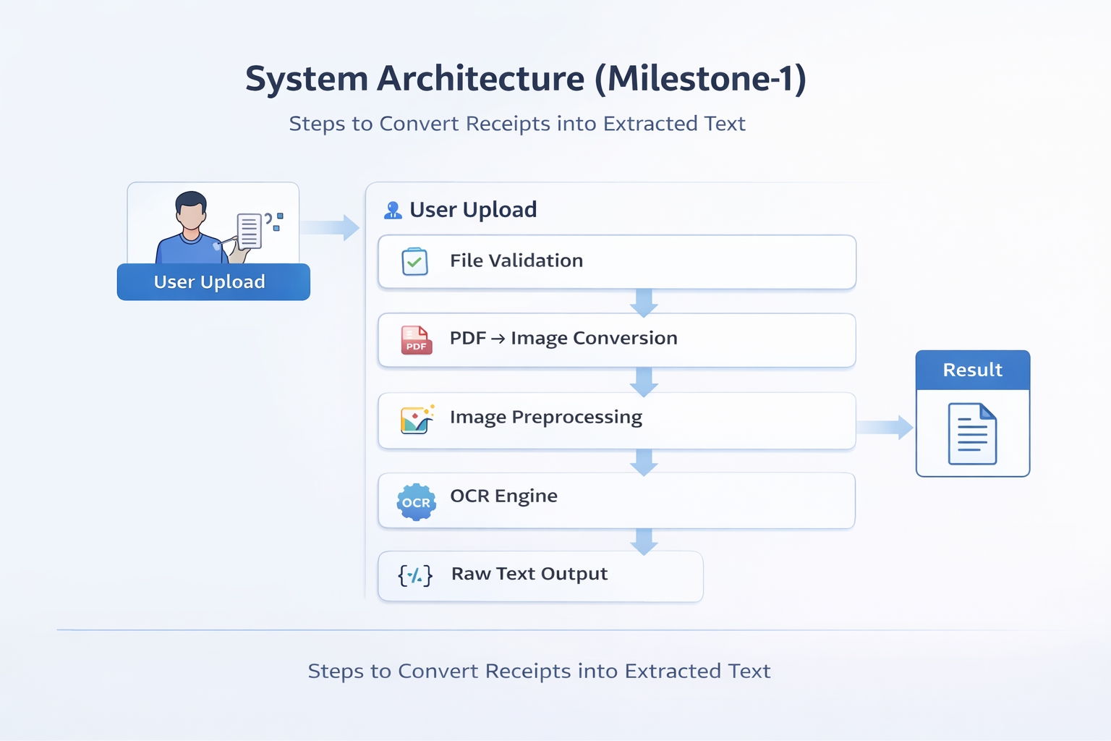
System Architecture

Slide 7

File Upload Module
Supports:
JPG
PNG
JPEG
PDF
Uploaded files stored locally
Duplicate receipt detection implemented
Benefits:
Simple UI
Fast processing
Prevents reprocessing same files

Slide 8
PDF to Image Conversion
PDFs converted using pdf2image
First page extracted as image
Enables OCR on scanned invoices
Why needed?
OCR engines work best on images
Ensures format compatibility

Slide 9
Importance of Image Preprocessing
Raw receipts may contain:
Noise
Shadows
Skewed text
Poor contrast
📌 Preprocessing improves OCR accuracy significantly.

Slide 10
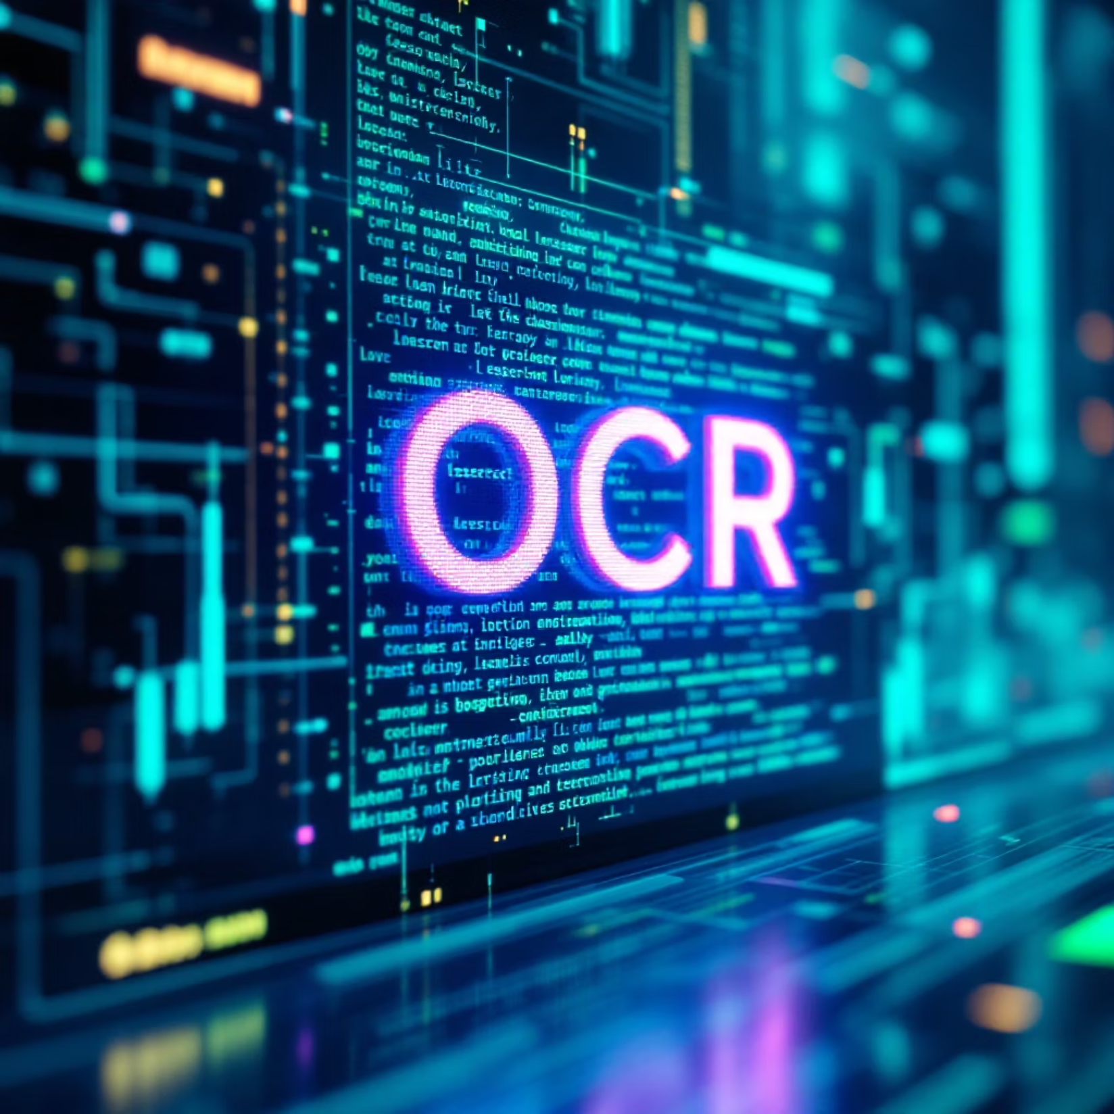
OCR Engine: Tesseract
Open-source OCR engine
Supports printed receipts
Configured with:
Multiple page segmentation modes
Confidence filtering
Extracts:
Store name
Dates
Items
Prices
Totals

Slide 11
OCR Output Example
Extracted Raw Text Includes:
Store name
Item list
Prices
Tax
Total amount
Payment information (if available)
✔ Cleaned and validated before AI processing

Slide 12
Introduction to Ollama (Local AI)
Ollama is a local Large Language Model runtime
Runs AI models on the local machine
No internet required
No API keys
No usage limits
📌 Introduced in Milestone-1 for AI readiness

Slide 13
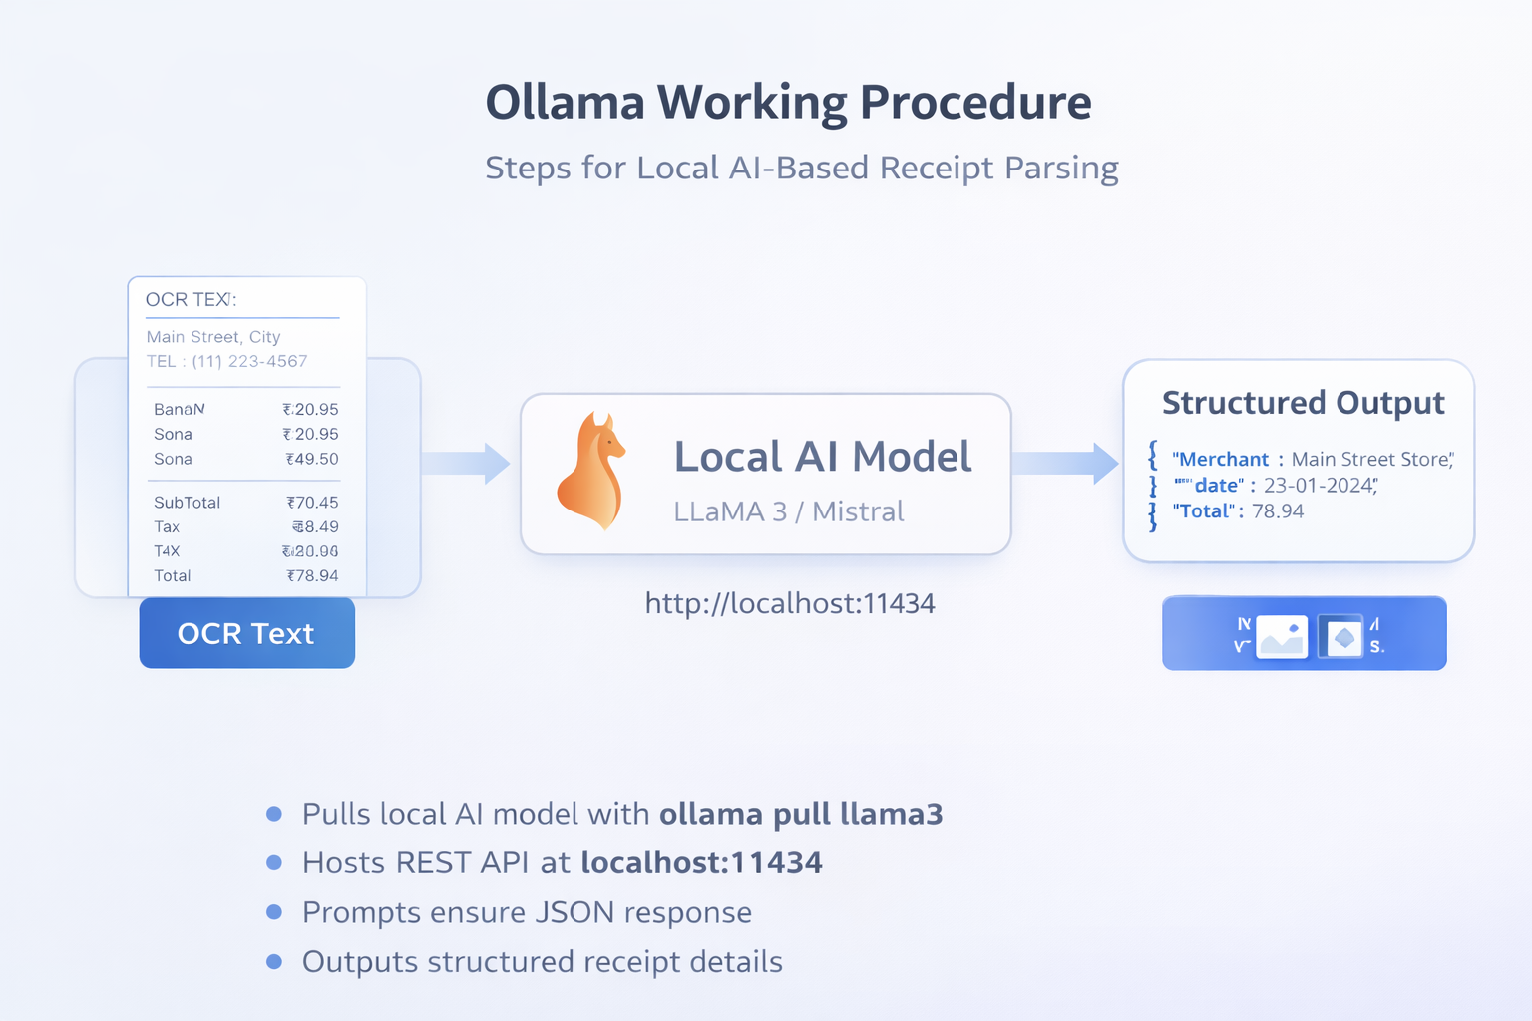
Ollama Working Procedure

Slide 14
Why Local AI (Ollama)?
100% Free
Data privacy
Low latency
Offline capability
No vendor lock-in
Ideal for sensitive financial data

Slide 15
Challenges Faced
Noisy OCR output
Different receipt layouts
Skewed and low-quality images
Mixed fonts and formats
✔ Solved using preprocessing and OCR optimization

Slide 16
Results & Observations
OCR accuracy improved significantly
Successfully extracted text from:
Restaurant receipts
Retail invoices
Supermarket bills
Stable OCR pipeline achieved

Slide 17
Milestone-1 Completion Status
✔ File upload implemented ✔ Image preprocessing completed ✔ OCR extraction successful ✔ PDF & image support ✔ AI-ready text generated

Slide 18
Conclusion
Milestone-1 successfully established the foundation of the Receipt & Invoice Digitizer system by enabling reliable document ingestion and OCR processing, preparing the project for intelligent AI-based extraction and analytics.

Slide 19
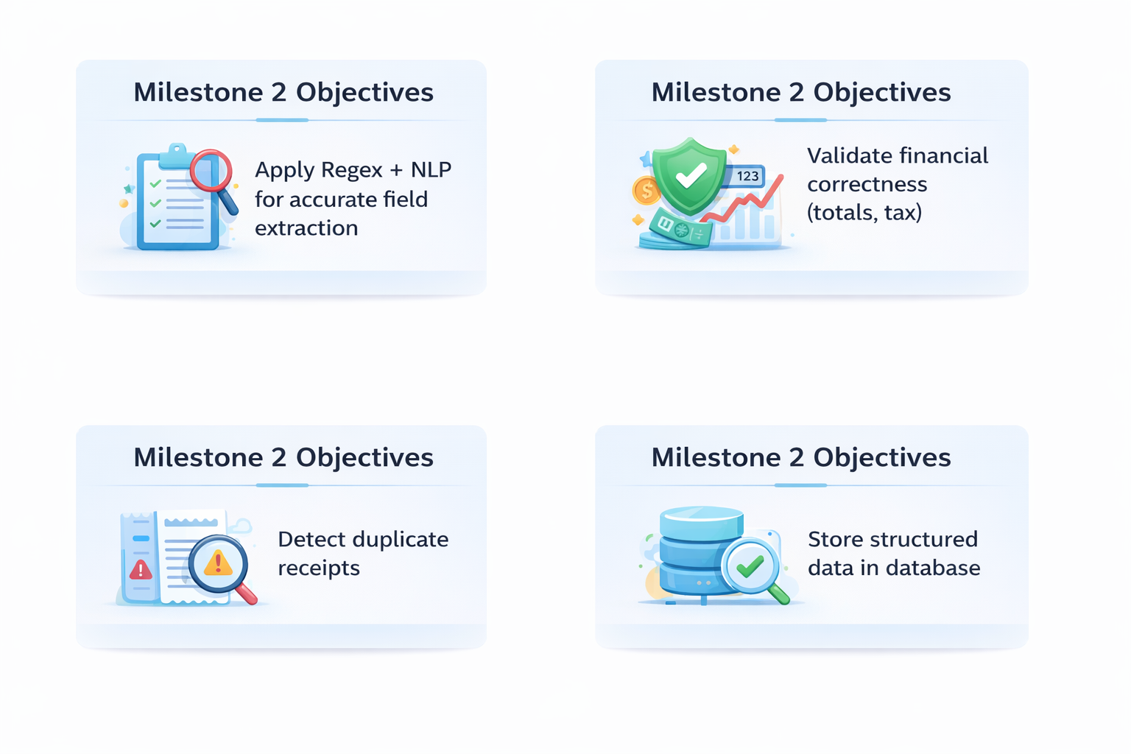
Milestone 2 Objectives

Slide 20
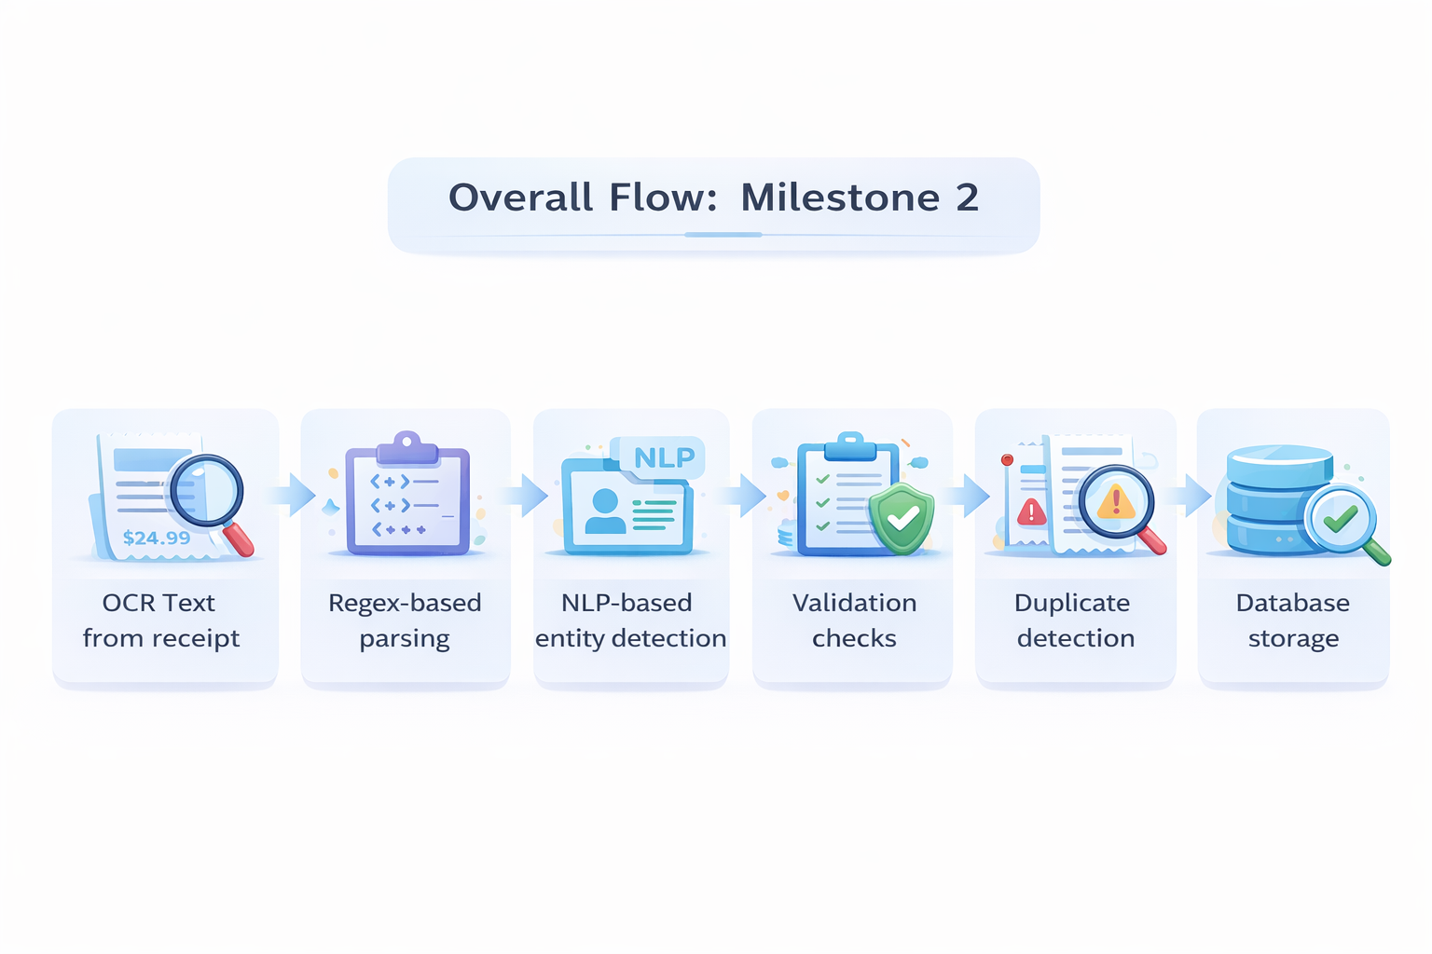

Slide 21
Regex Usage Overview
Regex is used to extract:
Line items & prices
Subtotal, tax, total
Numeric patterns

Slide 22
Line-Item Extraction Using Regex
Each OCR line is scanned
Matches pattern: Item Name + Price
Filters out:
Total
Tax
Subtotal
Service charges
Result: Clean list of purchased items

Slide 23
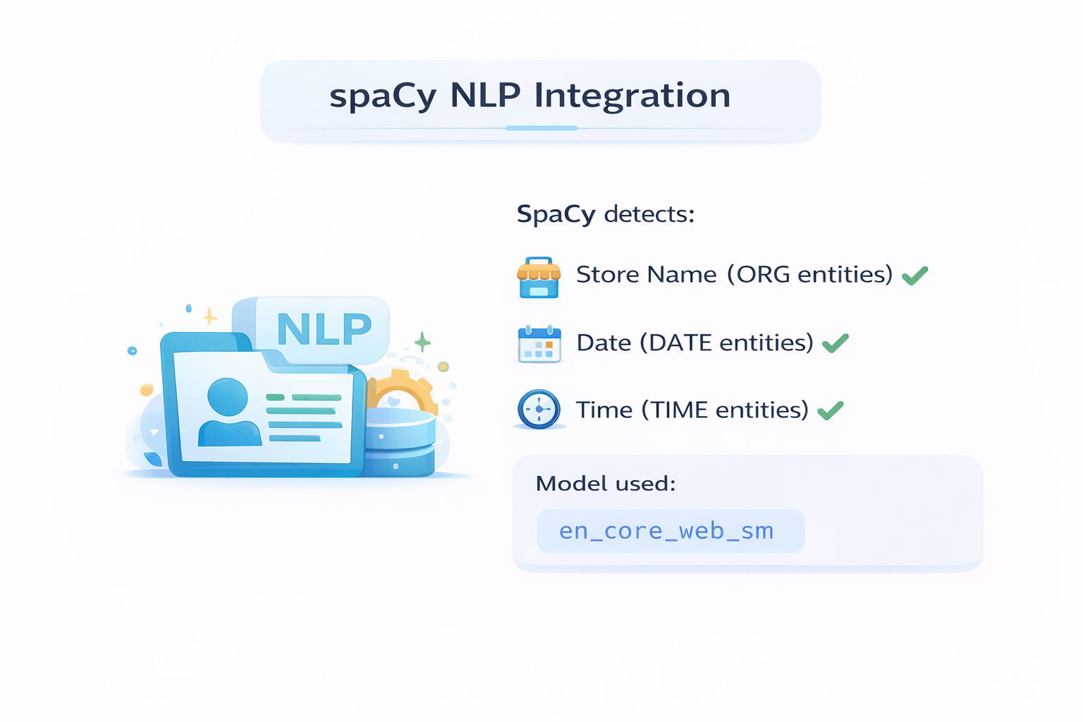

Slide 24
NLP + Regex Hybrid Approach
Why combine both?
Regex | NLP
Precise numeric extraction | Context understanding
Fast & deterministic | Handles OCR noise
Item-price parsing | Date & store detection

Slide 25
Extracted Fields
The system extracts:
Store name
Date
Time
Payment mode
Items list
Subtotal
Tax
Total

Slide 26
Validation Layer Overview
Validation ensures:
Financial correctness
Data completeness
Reliability before storage

Slide 27
Duplicate Detection
Each receipt file name is checked
SQLite query verifies existence
Prevents duplicate storage
User feedback:
“Receipt already exists in database”

Slide 28
Required Fields Validation
Checks presence of:
Store
Items
Subtotal
Total
Prevents saving incomplete receipts

Slide 29
Database Design
Two tables used:
receipts
id
filename
store
date
subtotal
tax
total
payment
uploaded_at
receipt_items
receipt_id
item_name
price

Slide 30
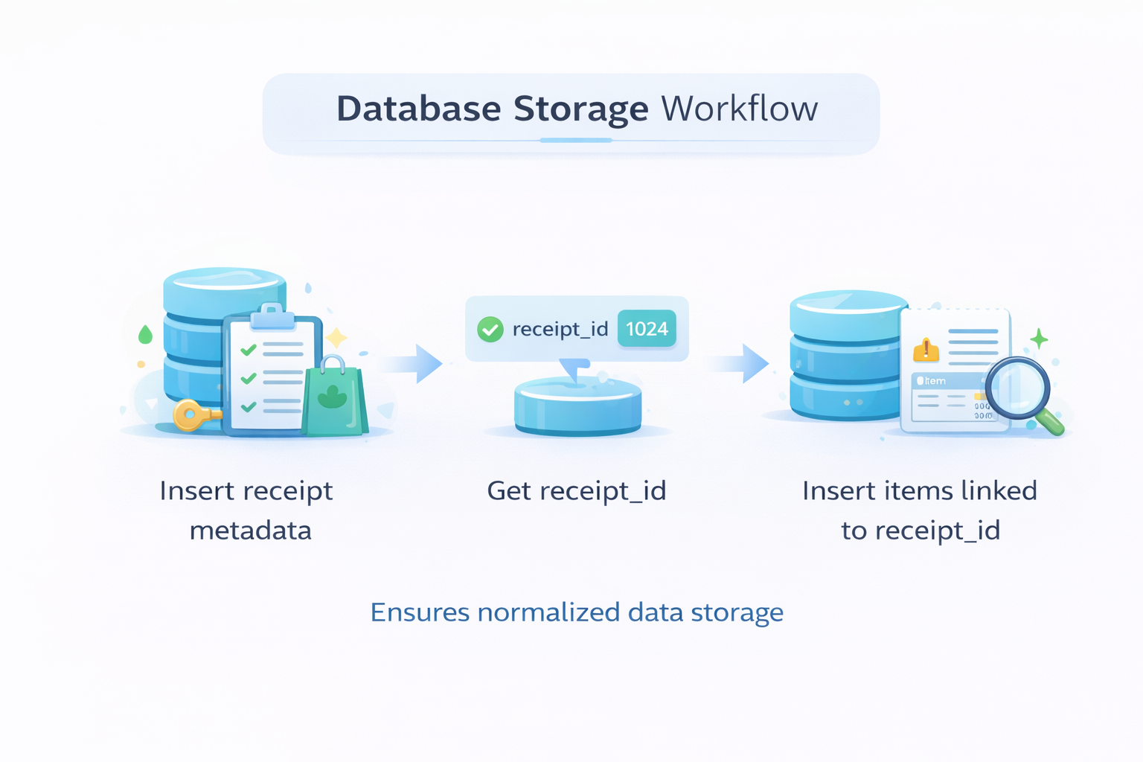
Database Storage Workflow
Insert receipt metadata
Get receipt_id
Insert items linked to receipt_id
Ensures normalized data storage

Slide 31
Error Handling
Handled cases:
Empty OCR output
Invalid totals
Missing fields
Duplicate files
All errors shown via UI banners

Slide 32
Output After Milestone 2
User can:
View extracted receipt
See validation banners
Save only valid data
View stored items late

Slide 33
Conclusion
Milestone 2 successfully:
Converts OCR text into structured data
Applies intelligent validation
Stores clean, reliable records
Prepares system for analytics (Milestone 3)

Slide 34
Thank YOU

